Slide 1
Alaska Department of Transportation & Public Facilities
Anchorage International’s
First Concrete Runway
Three Years In
Mitch Miller, PE
ADOT&PF Central Region Materials
November 24th, 2014

Slide 2
ANC Background
Alaska’s Largest Airport
Three runways over 10,600 ft.
One over 12,000 ft
Equidistant from Tokyo and New York
The primary stopover for cargo moving between the US and Asia
9 hours from 90% of the industrialized world

Slide 3
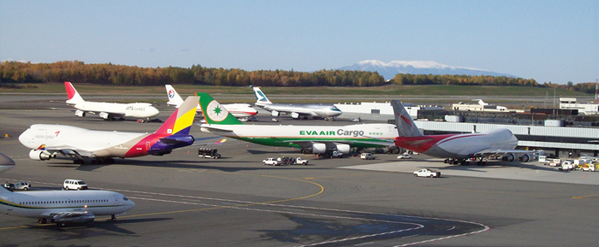
ANC Background

Slide 4
2013 WORLDS TOP 10 BUSIEST CARGO AIRPORTS
RANK | AIRPORT | 1,000's tons
1st | Memphis | 4,134
2nd | Hong Kong | 4,127
3rd | Shanghai Pudong International | 2,856
4th | Dubai International | 2,436
5th | Anchorage International (ANC) | 2,421
6th | Seoul Incheon International | 2,395
7th | Louisville International | 2,145
8th | Fankfurt International | 2,016
9th | Tokyo Narita International | 1,980
10th | Miami International | 1,909
Notes:
5th busiest in the world
AND
2nd busiest in the US

Slide 5
ANC Background
ANC’s Three Runways
N-S Runway 14-32
E-W Runways 7R-25L and 7L-25R
All Asphalt Pavements Historically

Slide 6
Project Background
Runway 7R-25L
Originally constructed in 1969
4” HMA over
8” Bituminous Base Course
100+” Subbbase
Supports the majority of “Wide Body” Traffic (B-747, B-777, A-340, MD 11, etc.)
Intermittent shave and pave rehabs
After increasing frequency of partial rehabs full reconstruction was in order

Slide 7
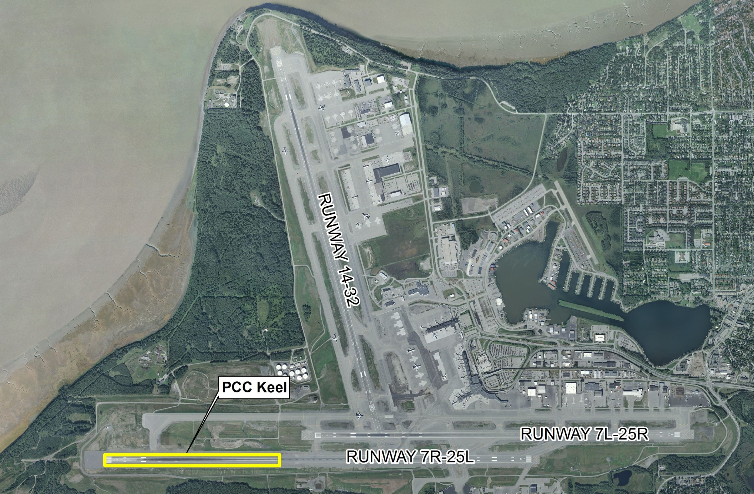
ANC Background

Slide 8
Project Background
2010 - Phase I of the reconstruction project rehabilitated the east half of 7R with HMA surface
2011 - Phase II reconstructed and extended the west half of the runway including 5,000 ft PCC concrete keel

Slide 9
Project Background
PCC section was located at the west end of the runway in the touchdown area of 7R
Where the asphalt runway repairs were most often required
PCC pavement designed using FAA AC 150/5320-6E Airport Pavement Design and Evaluation
Notes:
Where the historical damage has occurred requiring shave and pave rehabs the most frequently

Slide 10
Project Background
Resulting PCC Pavement Design
21” PCC slab depth (26” at edge)
Included 4” stabilized base
95” Subbase
PCC Keel varied in width from 100 ft to 80 ft
Approx. 20’x20’ slab dimension
1.5” x 24” dowel bars 12” OC spacing through all joints

Slide 11
Project Background
Contract Requirements for PCC Pavement Construction
A PCC super intendant with min. 10 years experience on similar scale projects
Required slip form placement of PCC

Slide 12
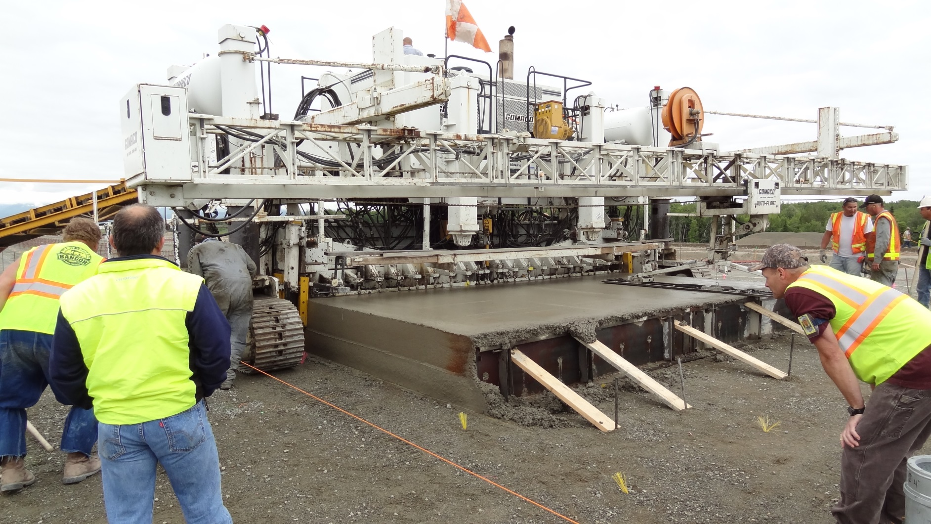
Project Background

Slide 13
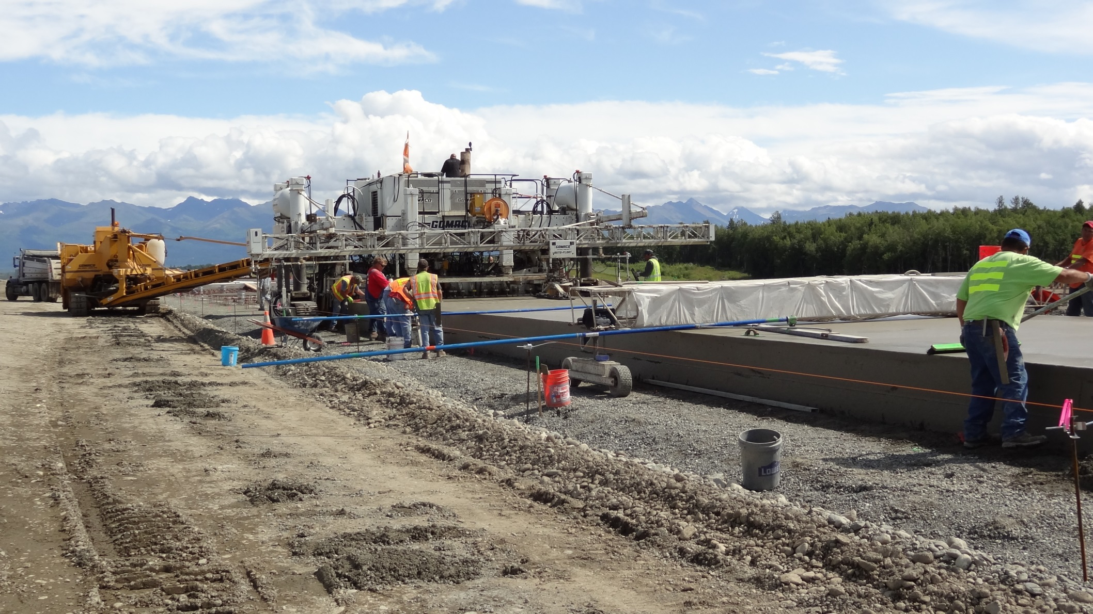
Project Background

Slide 14
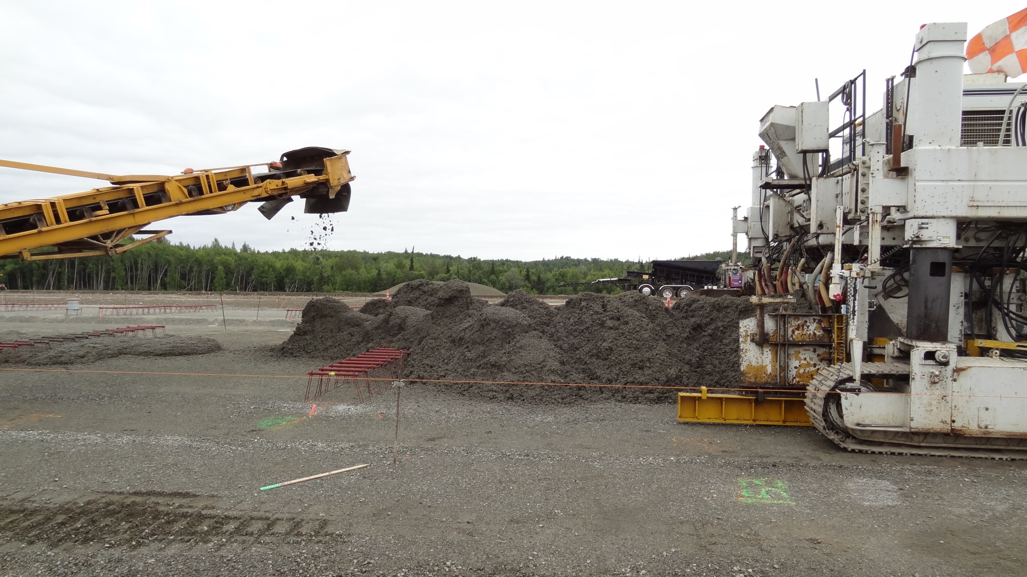
Project Background

Slide 15
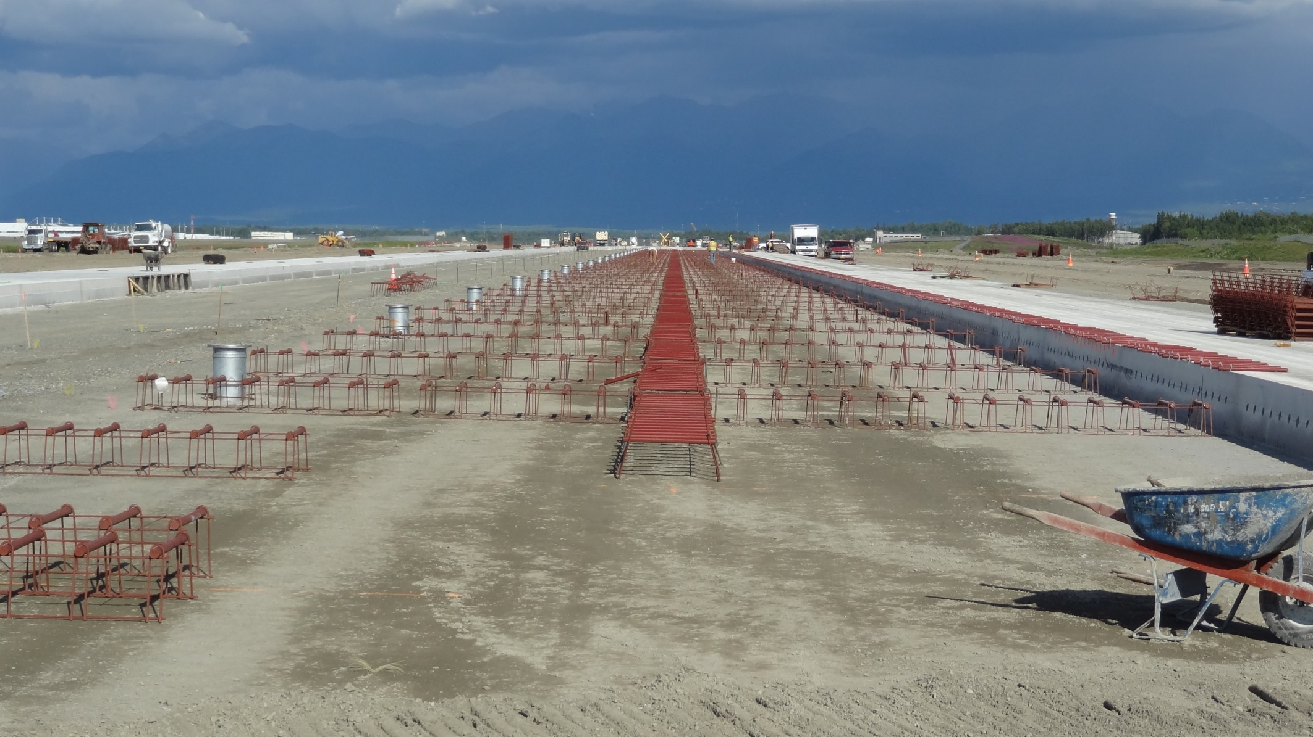
Project Background

Slide 16
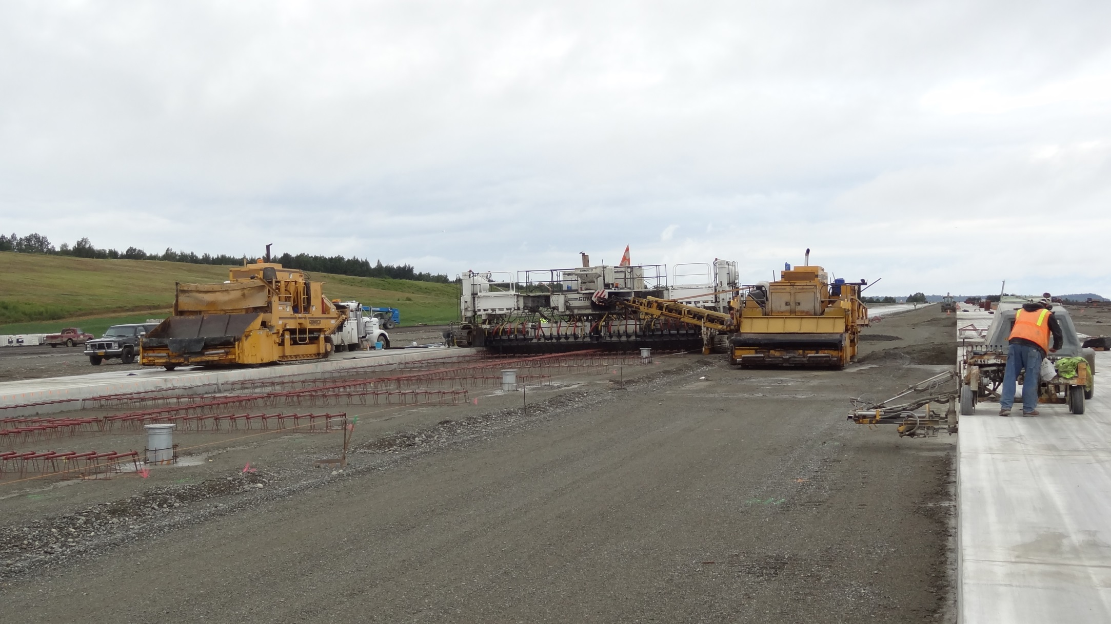
Project Background

Slide 17
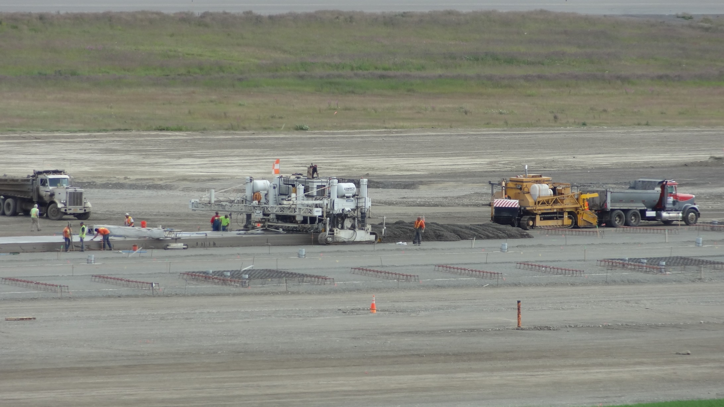
Project Background

Slide 18
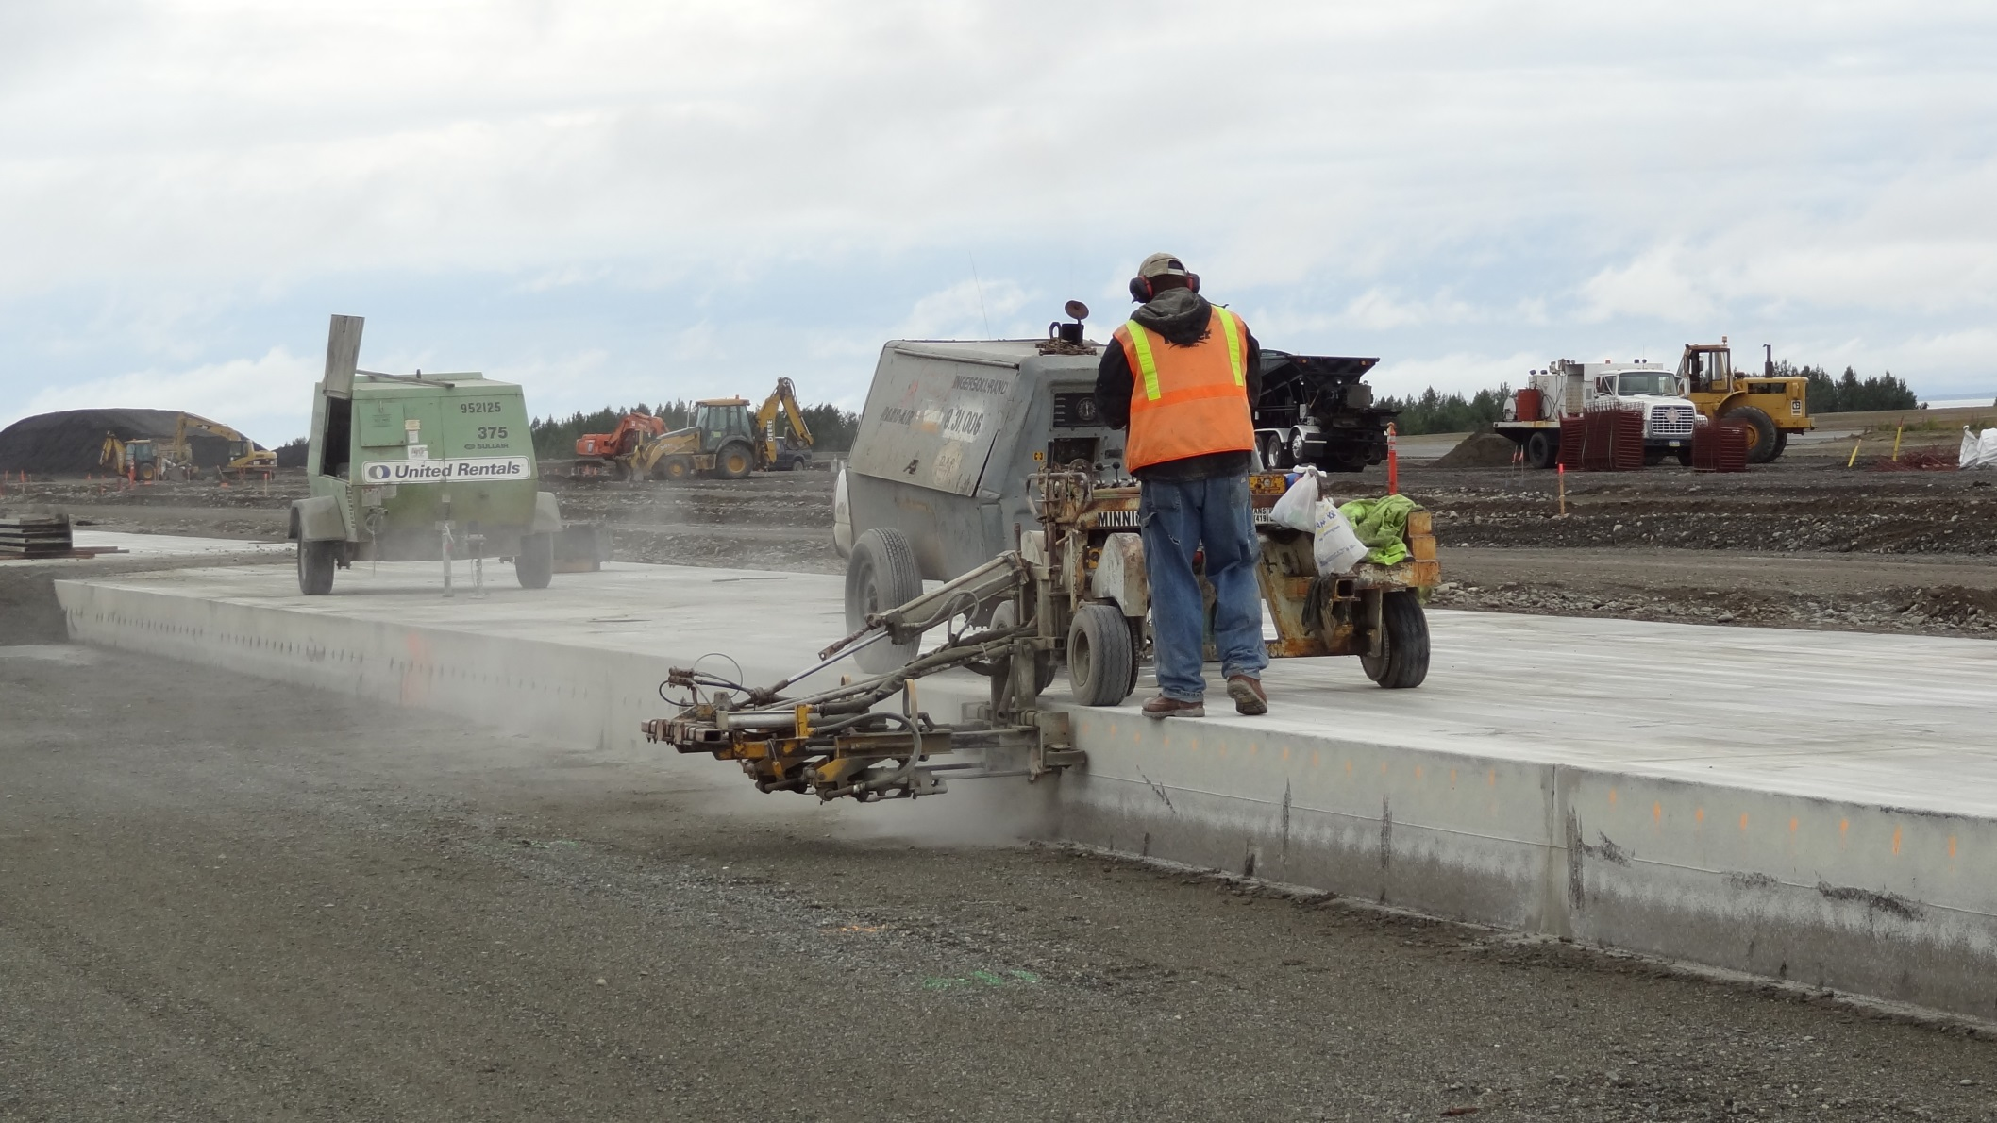
Project Background

Slide 19
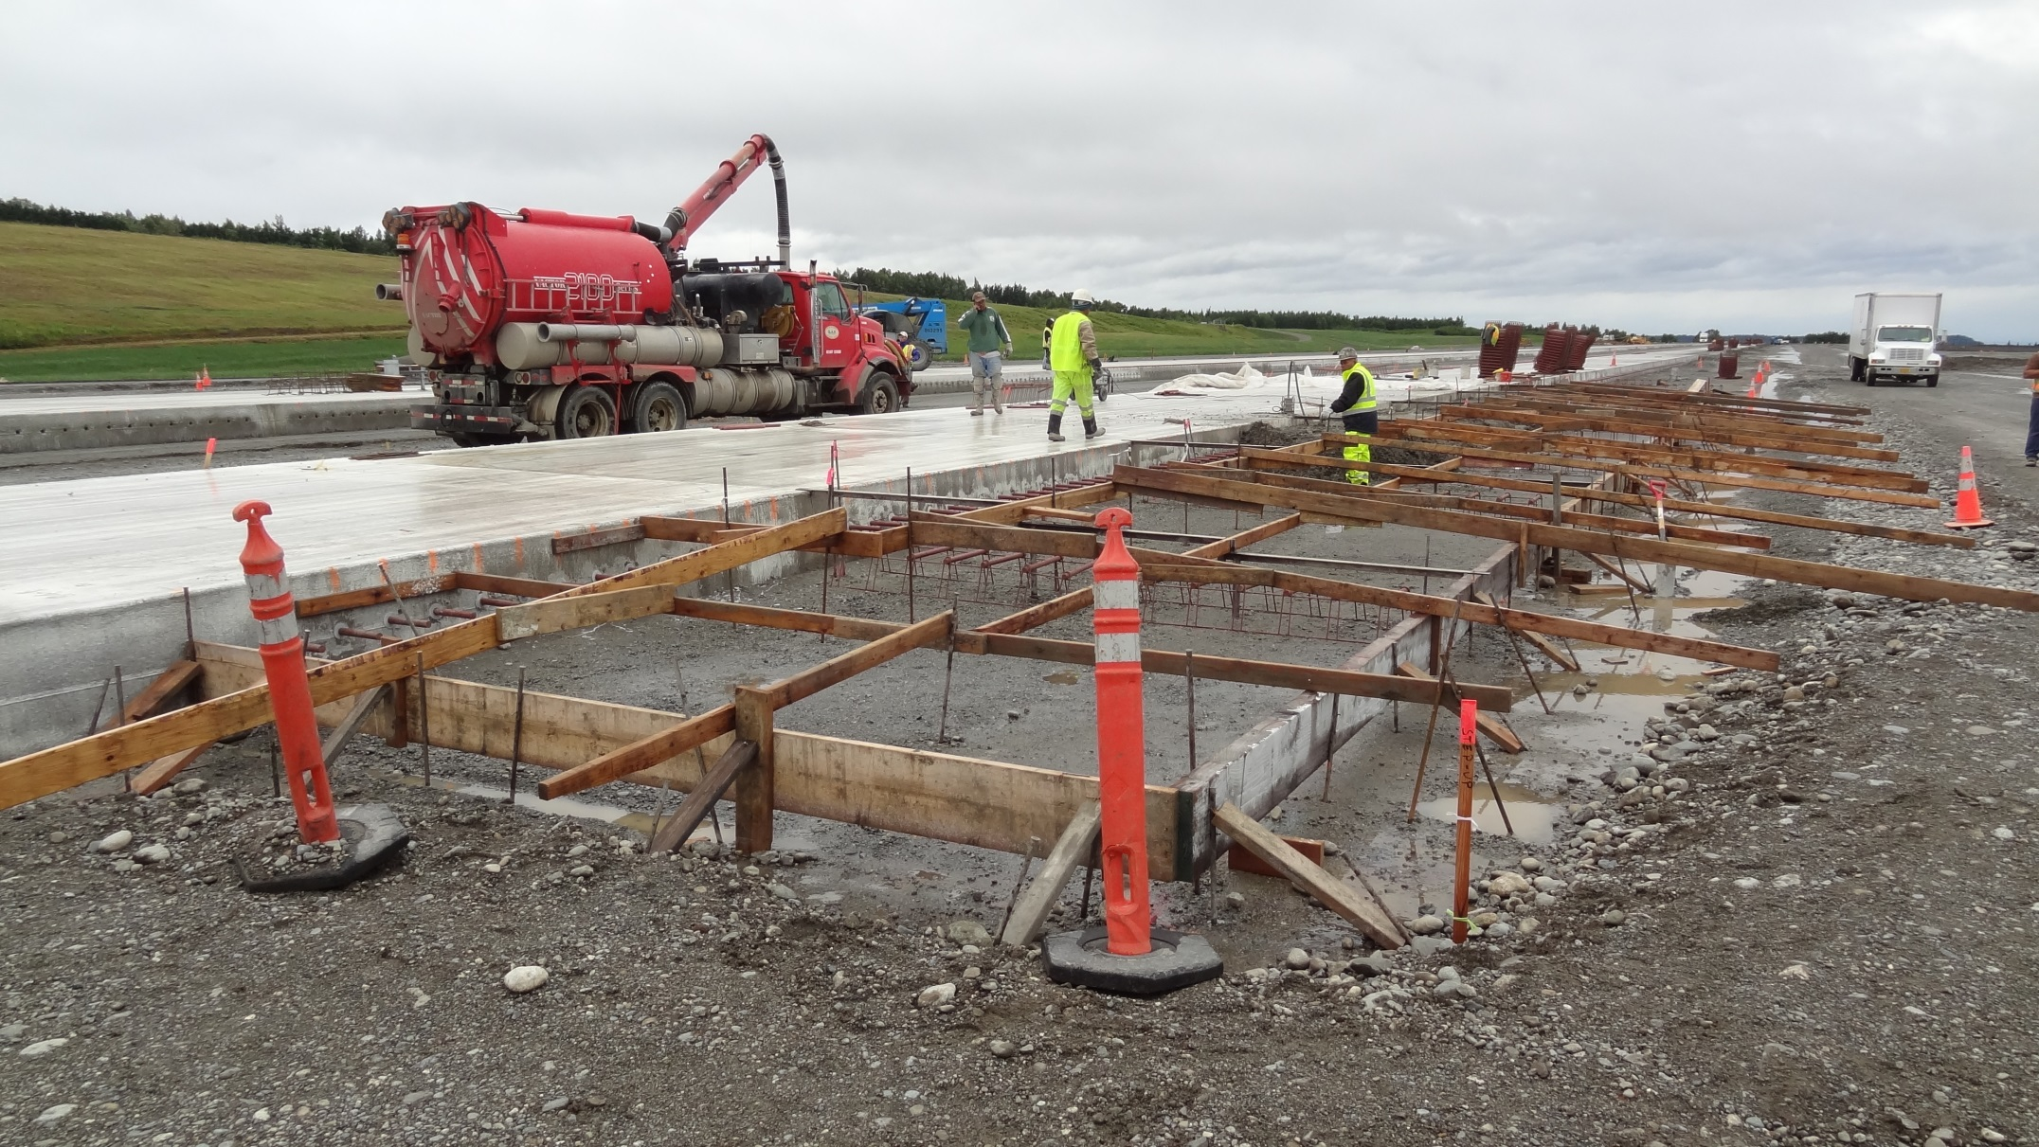
Project Background
Construction went smoothly (relatively) until…
Notes:
Relatively

Slide 20
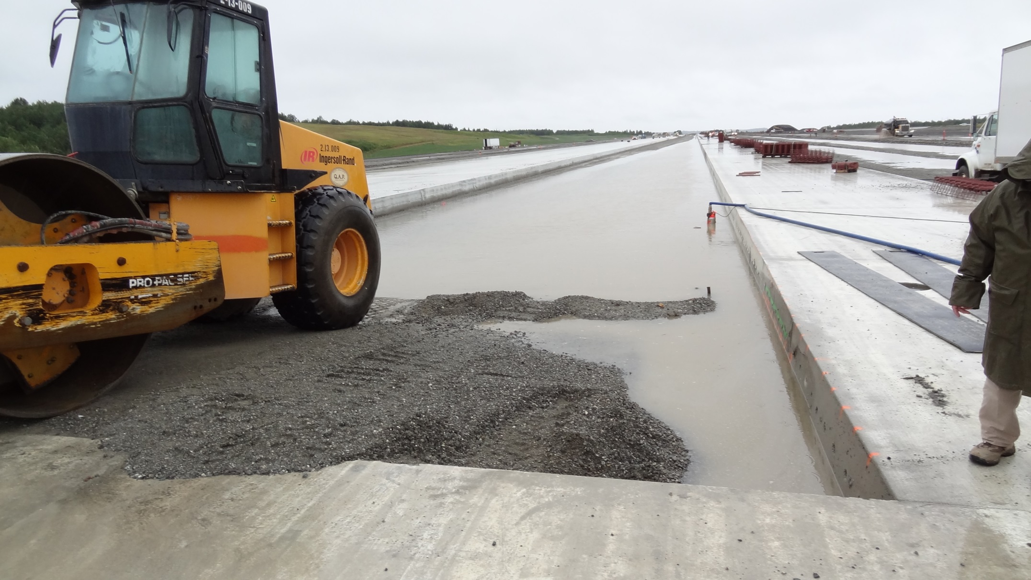
7R-25L Canal
Project Background

Slide 21
Project Background

Slide 22
Project Background
Original Construction Summary
Some uncontrolled cracking resulted in a few slab replacements and some minor cracks being filled with epoxy resin

Slide 23
Project Background
Issues following first winter in service
Record snowfall 2011-2012 (133 inches at ANC)
Edge spalling created FOD on the runway (particularly at centerline)
Preformed compression seals depressed into joint reservoir
1”-3” Heave between HMA and PCC

Slide 24
Partial Depth Repair (PDR)
Summer 2014 the Department completed a mock up PDR project to test repair practices in anticipation of a larger PDR project in the coming years.
The initial project determined:
how deep a typical repair will be (needed to define scope for bidding)
a baseline tensile strength of the existing concrete so an acceptance bond strength can be set
removal and prep practices that provided the best bond between patch material and existing concrete
Concrete Consulting Engineers, LLC (CCE) helped the Department put the project together and is helping with the distillation of collected information.
Notes:
Its purpose was to define an effective procedure for edge spall repair and determine an acceptance criteria on which future work can be accepted.

Slide 25
Partial Depth Repair (PDR)
Mock up description:
Twenty five (25) 20’x20’ panels were selected for PDR work
Approximately 40 repairs were performed on those 25 panels
The entire centerline along the test site was removed and replaced
Repair materials included standard concrete, elastomeric concrete and FAA approved epoxy resin
Tensile strength of existing concrete and bond between the patch and existing concrete was tested using ASTM C1583
Remove and replace existing preformed compression seal with a wider version to increase sidewall pressure
Note: ASTM C 1583 Standard Test Method for Tensile Strength of Concrete Surfaces and the Bond Strength or Tensile Strength of Concrete Repair and Overlay Materials by Direct Tension

Slide 26
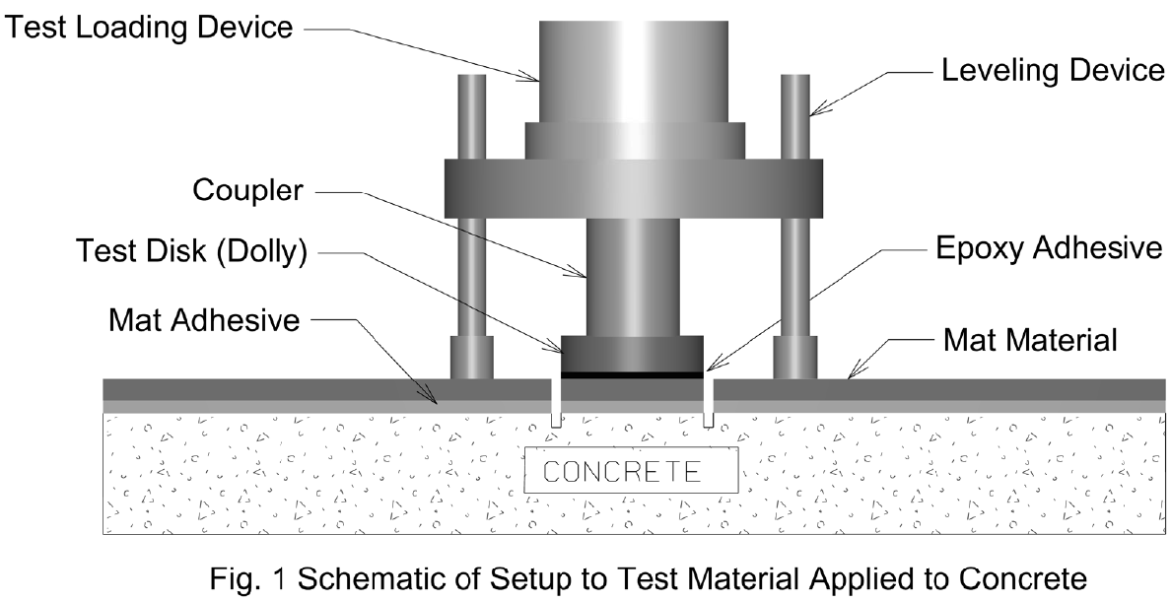
Partial Depth Repair (PDR)
ASTM C 1583 Test Device

Slide 27
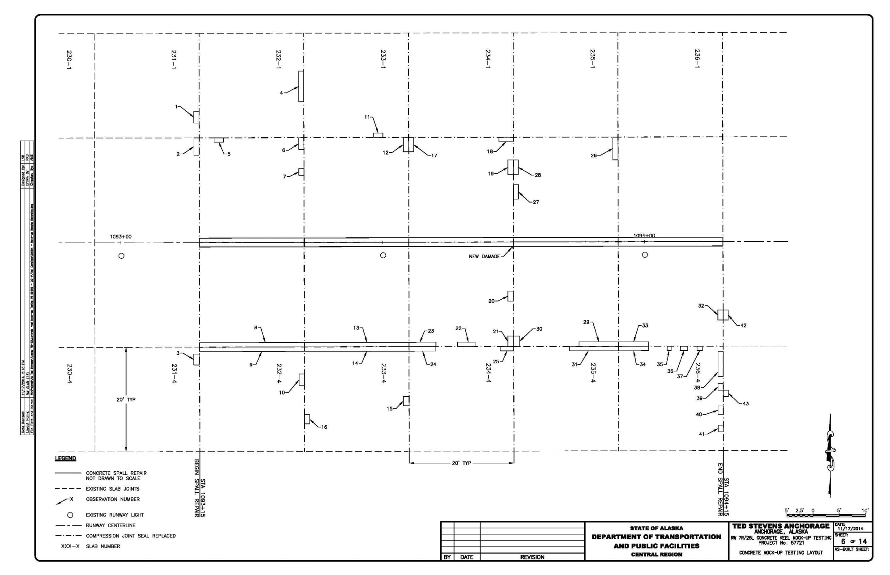
Partial Depth Repair (PDR)

Slide 28
Partial Depth Repair (PDR)
REMOVAL: Multiple methods were used
Chipping hammer (15-lb max)
Mill
Hydrodemolition
Tensile strength testing of the prepped surface was performed to determine which method produced the least amount of substrate bruising.
Testing in cavities was challenging.

Slide 29
Partial Depth Repair (PDR)

Slide 30
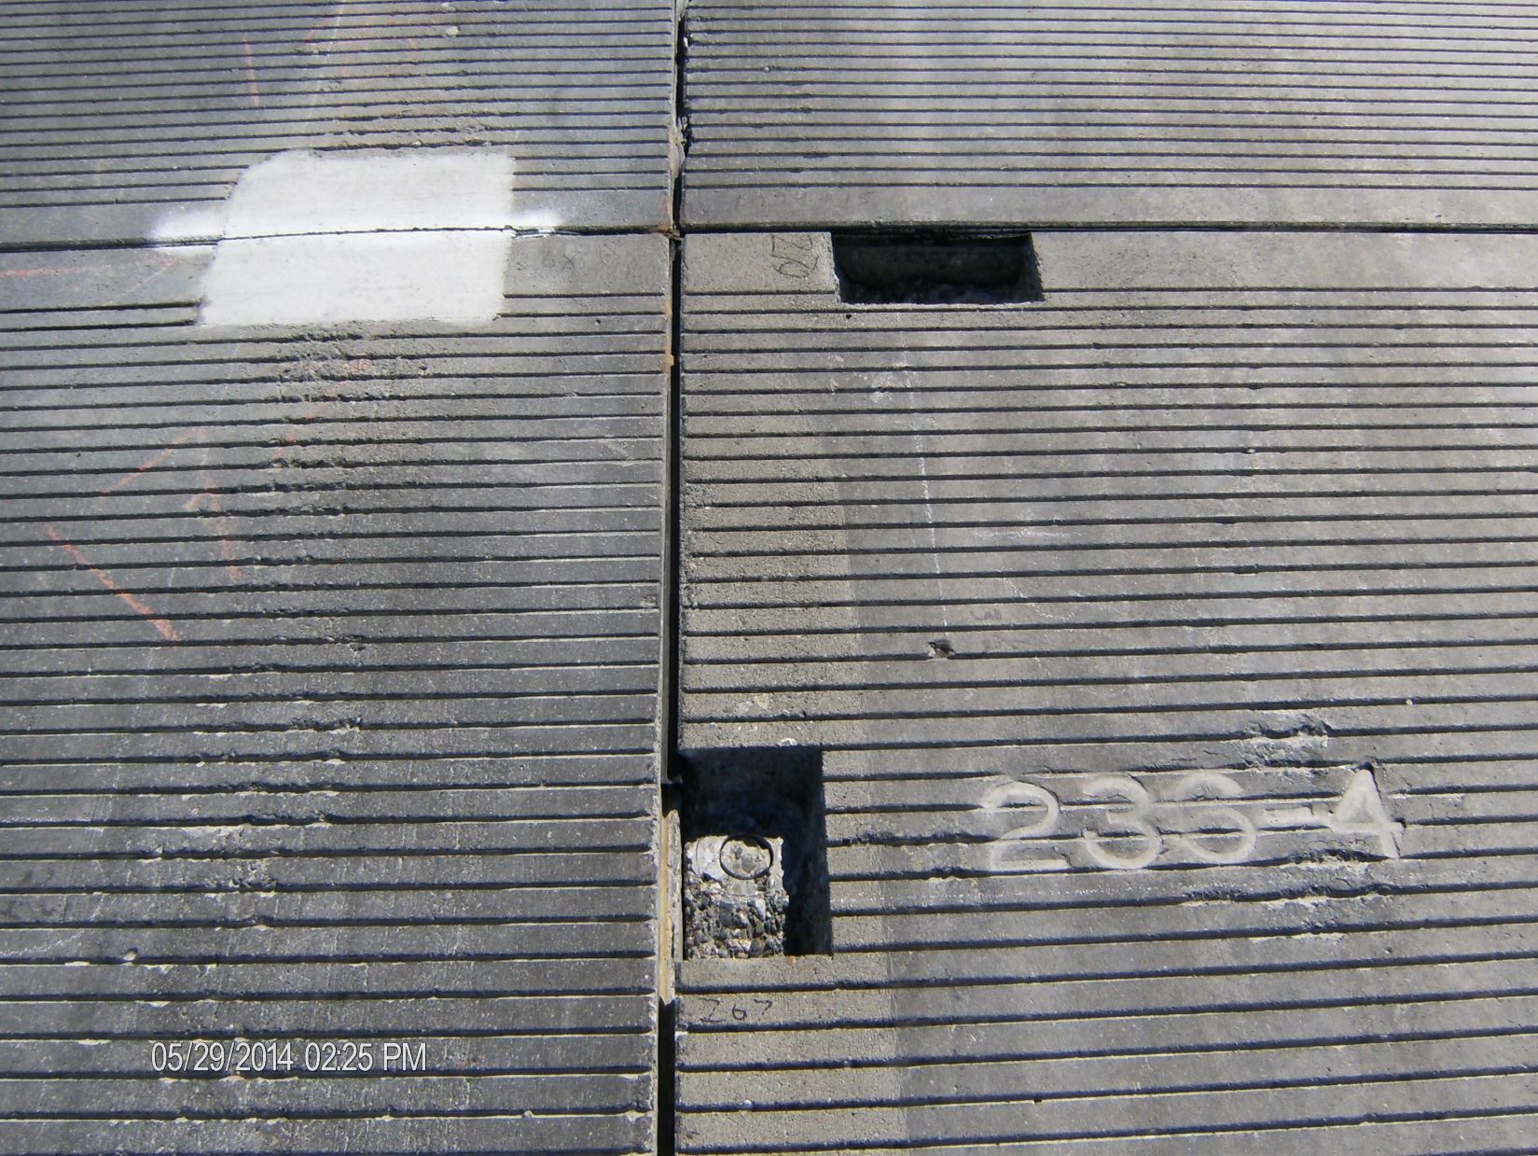
Partial Depth Repair (PDR)

Slide 31
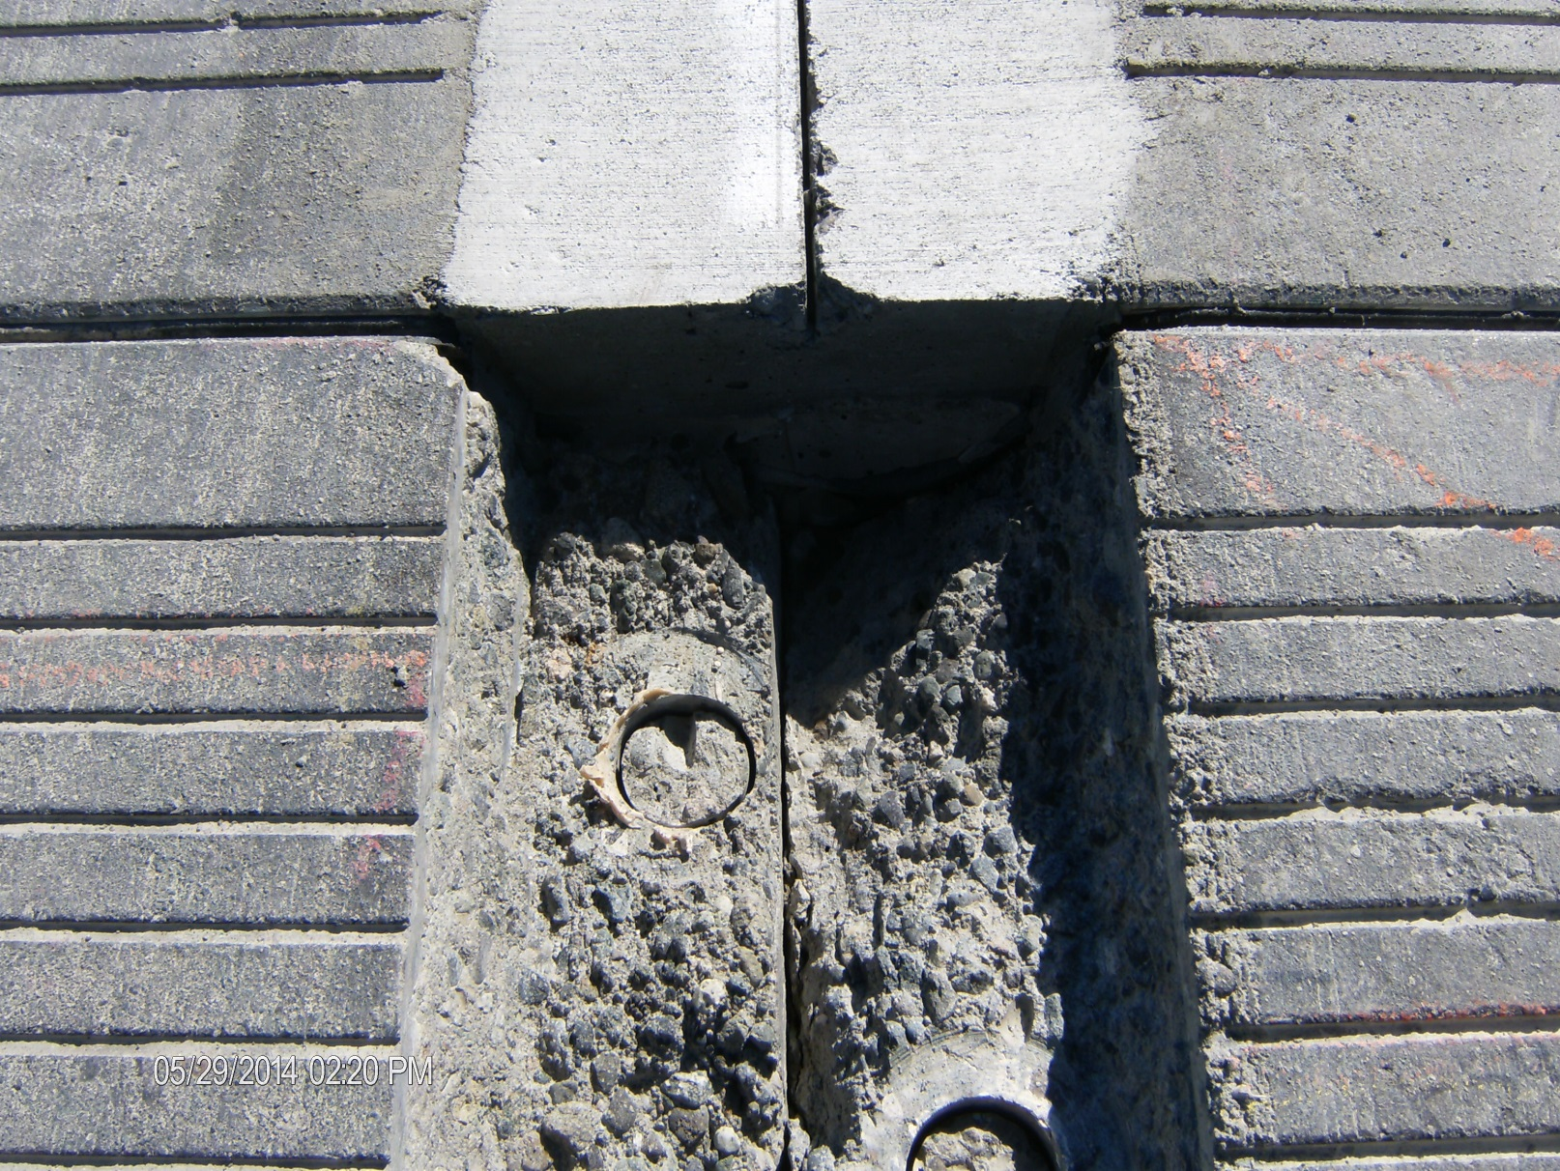
Partial Depth Repair (PDR)

Slide 32
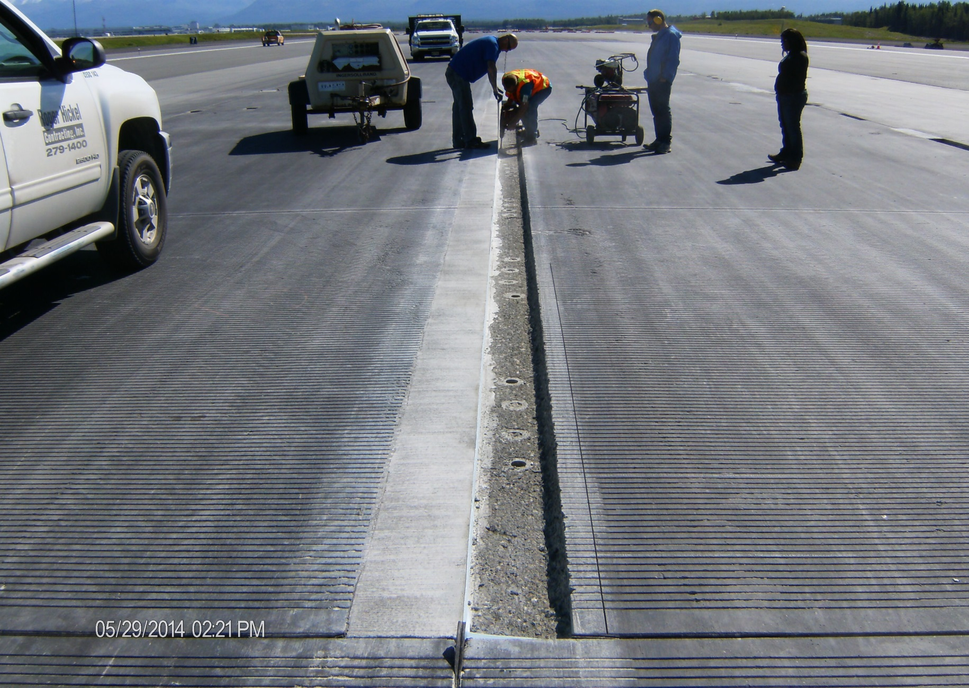
Partial Depth Repair (PDR)

Slide 33
Partial Depth Repair (PDR)

Slide 34
Partial Depth Repair (PDR)
Testing Bond Between Patch Material and Substrate
ASTM C 1583 used again to test the bond strength of the patch material to the existing concrete. The expectation is the result should be at least as high as the tensile strength of the substrate PCC.

Slide 35
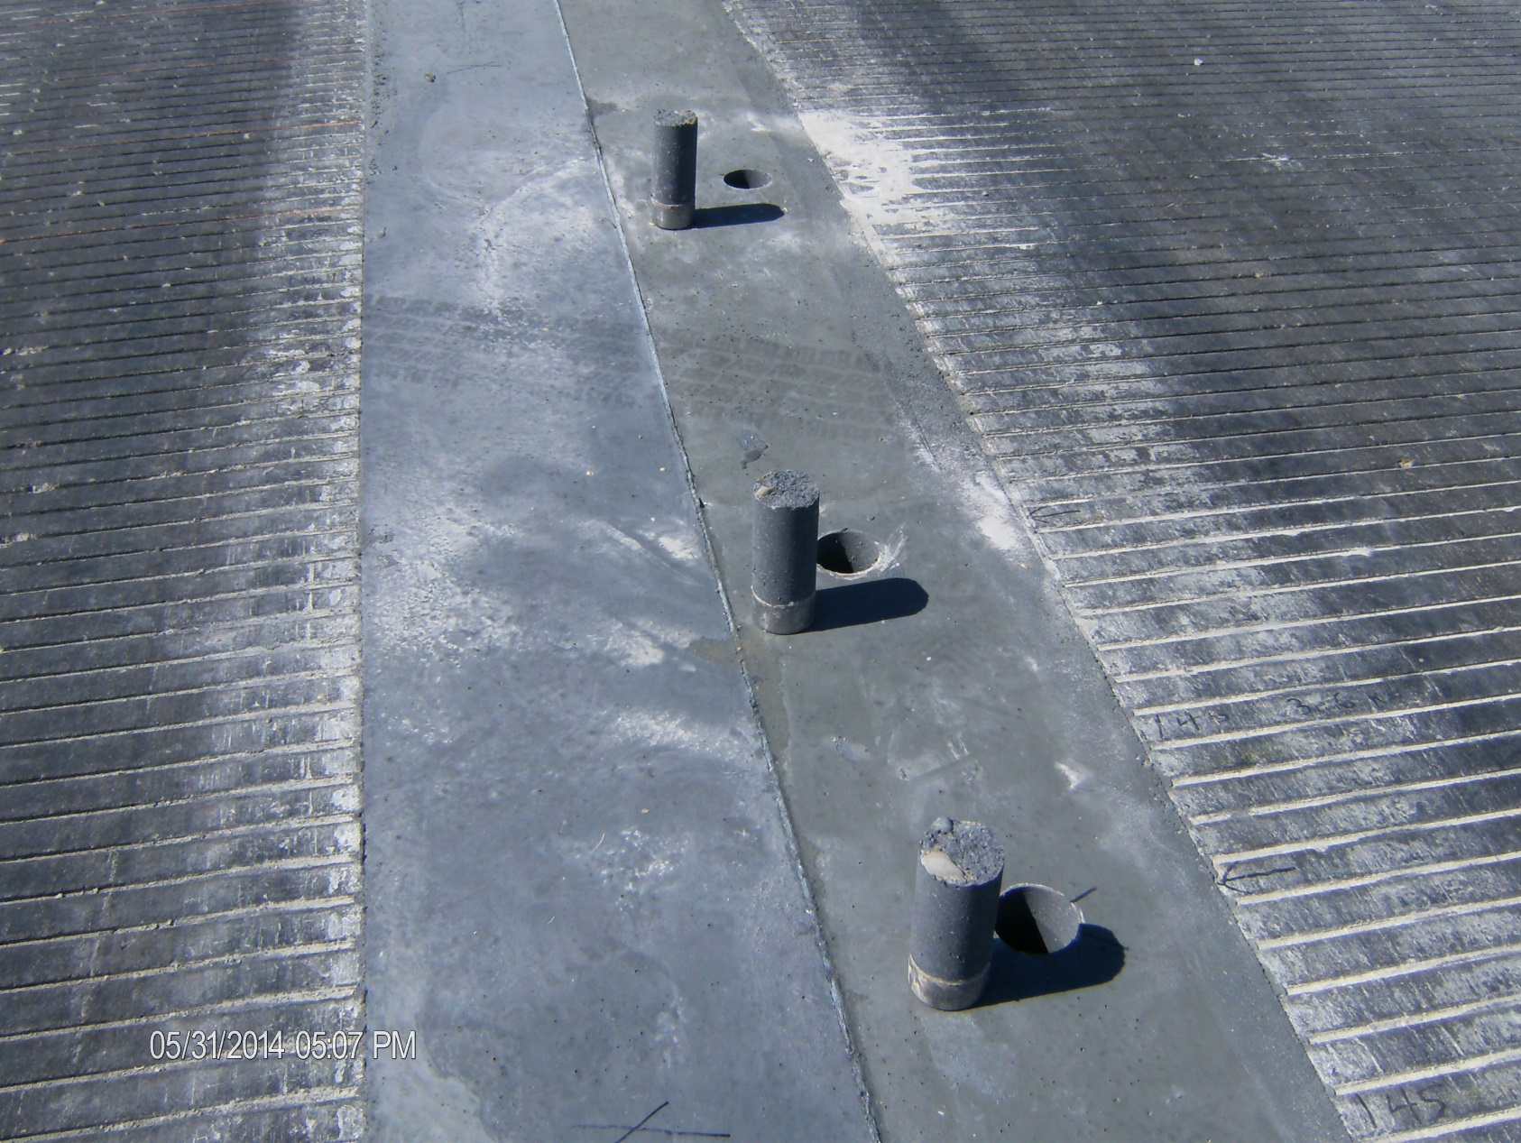
Partial Depth Repair (PDR)

Slide 36
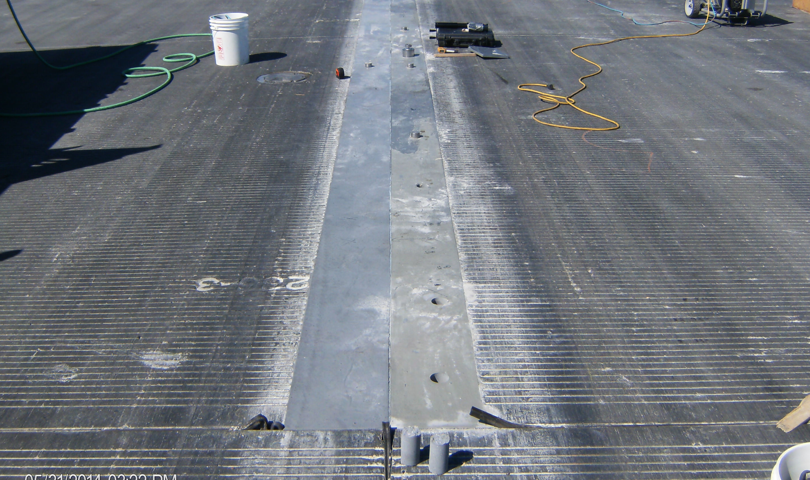
Partial Depth Repair (PDR)

Slide 37
Partial Depth Repair (PDR)
Results
Looks like hydrodemolition is the way to go for removal
Repair depths will be approximately 3-4 inches deep
Repair materials will be monitored for performance over the winter
PCC is the easiest material to place
Repair areas were wider for mock up project so we could test substrate at each location
We will probably not fix as many spalls as originally planned
(probably use a liquid sealant along joint faces where multiple small spalls have resulted in a rough reservoir edge)

Slide 38
Maintenance
Observed differences between
PCC vs. HMA
PCC requires extra chemical treatment (often prior to anticipated snow or ice events) due to increased icing and reluctance to use hard edged removal equipment
PCC repairs take more thought, time and expertise to perform properly
Considerable heaving issues the first winter along the HMA-PCC longitudinal joint (less of problem the following winter)

Slide 39
Future PCC Pavements
Large busy taxiway intersection that supports a lot of “wide body” turning movements.

Slide 40
Future PCC Pavements
Questions?

